Slide 1
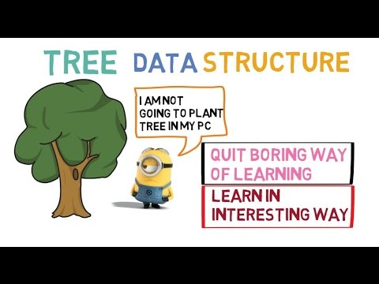
Welcome to CSE 220:
DATA STRUCTURE
Who Am I?
Jannatun Noor
Jannatun.noor@bracu.ac.bd

Slide 2
Necessary Information
From my site https://sites.google.com/site/jannatun0abigzero/teaching
Marks will be updated on this site.
Slides are also available there
MUST present in the class within first 5 minutes to learn everything effectively.

Slide 3
Tentative Mark Distribution
Section | Marks (%)
Participation in class | 5 %
Quizzes/Class Tests | 15%
Mid Term Examination | 20 %
Lab including Lab Assignments | 25 %
Final | 35 %
Total | 100 %

Slide 4
Books
Algorithms in Java, (3rd Edition), by Robert Sedgewick (main course textbook)
Data Structures by Seymour Lipschutz

Slide 5
Data Structures
In computer science, a data structure is a data organization, management and storage format that enables efficient access and modification. More precisely, a data structure is a collection of data values, the relationships among them, and the functions or operations that can be applied to the data.

Slide 6
Topics to cover
Arrays
Linear Array
Circular Array
2D Array
Linked Lists
Singly Linked List
Doubly Linked List
Stacks
Queue
Trees
Graphs
Others

Slide 7
Applications
Arrays
Linear Array
Circular Array
2D Array
Linked Lists
Singly Linked List
Doubly Linked List
Stacks
Queue
Trees
Graphs

Slide 8
Class & Object
An object represents an entity in the real world that can be distinctly identified.
For example, a student, a desk, a circle, a button, and even a loan can all be viewed as objects. An object has a unique identity, state, and behavior.
■ The state of an object (also known as its properties or attributes) is represented by data fields with their current values. A circle object, for example, has a data field radius, which is the property that characterizes a circle. A rectangle object has data fields width and height, which are the properties that characterize a rectangle.
■ The behavior of an object (also known as its actions) is defined by methods. To invoke a method on an object is to ask the object to perform an action. For example, you may define a method named getArea() for circle objects. A circle object may invoke getArea() to return its area.

Slide 9
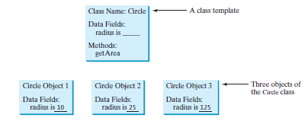

Slide 10
Java data types
Java primitives
Numeric
Non-numeric
Boolean
Byte
Int
…
char
String

Slide 11
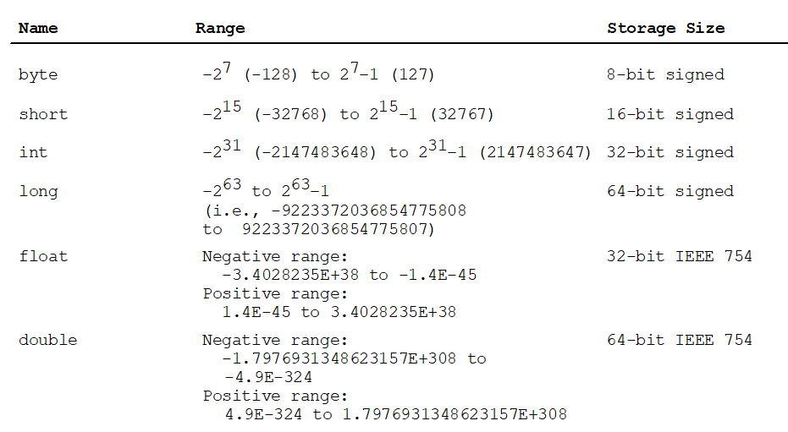
Java Numerical Primitives

Slide 12
Variables
public class Example1
{
public static void main ( String[] args )
{
int payAmount = 123;
System.out.println("The variable contains: " + payAmount );
}
}

Slide 13
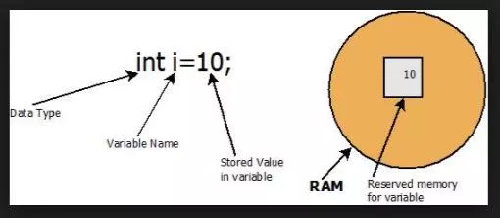
Variables in Java Memory

Slide 14
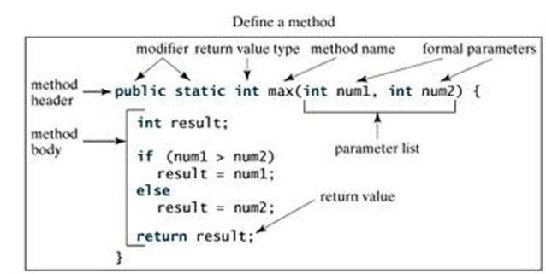
Methods

Slide 15
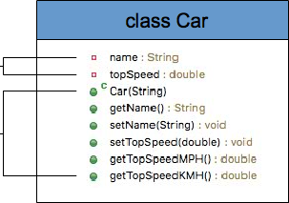
Class
variables
methods

Slide 16
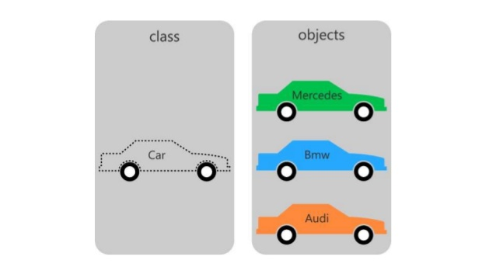
Objects

Slide 17
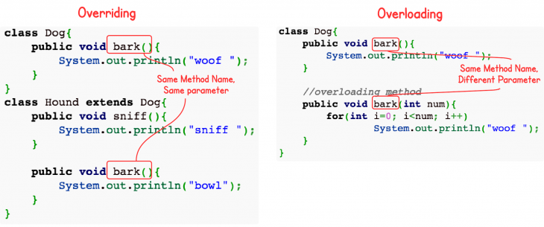
Overloading and Overriding

Slide 18
Assignments !!! 12 marks
Will be given in my Site
Submit the assignments at due time.
No assignment will be allowed after the deadline. [Strictly]
Never ignore assignments. That will lower your grade.

